Slide 1


INTRODUCTION TO C

Slide 2
Today’s Outline
Brief history of C
Constants and Variables
Keywords
Data Types in C
Operators
Storage Class
Functions
Conditional statements

Slide 3
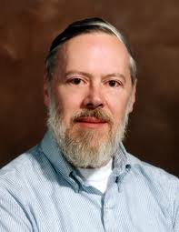
Brief history of C
DENNIS RITCHIE

Slide 4

Brief history of C
C is one of the most widely used
programming languages of all time.
C has a wide range of flexibility and
“You can program ANYTHING in C.”

Slide 5
PROGRAM STRUCTURE
A C program basically has the following form:
Pre-processor Commands
Functions
Variables
Statements & Expressions
Comments
#include <stdio.h>
int main()
{
/* My first program */
printf("Hello, World! \n");
return 0;
}

Slide 6
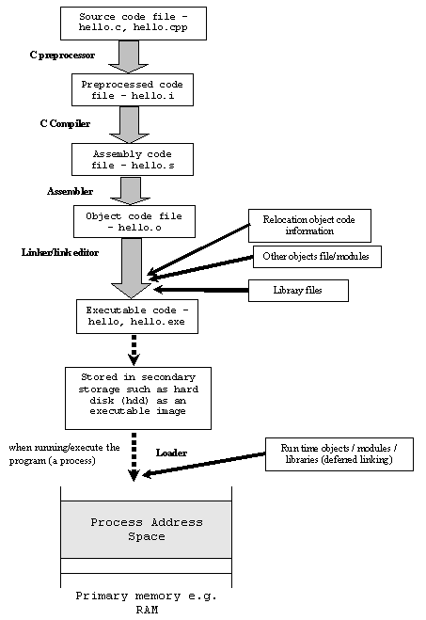

Slide 7
CONSTANTS
CONSTANTS : They are those data items that RETAIN same values in a program.
CONSTANTS
ALPHANUMERIC
NUMERIC
CHARACTER
‘A’
STRING
“ABC”
INTEGER
1 , -2,0
FLOATING
7.9 , 2.00

Slide 8
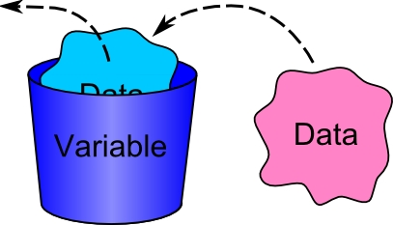
VARIABLES
THESE ARE DATA ITEMS WHOSE VALUES MAY
OR MAY NOT CHANGE DURING THE COURSE OF PROGRAM
➔Variable name should start with an alphabet/underscore
and should not contain any blank spaces.

Slide 9

KEYWORDS
KEYWORDS : These convey a special meaning to the C compiler and
cannot be used as variable names.
If
for
else
while

Slide 10
KEYWORDS
auto | else | long | switch
break | enum | register | typedef
case | extern | return | union
char | float | short | unsigned
const | for | signed | void
continue | goto | sizeof | volatile
default | if | static | while
do | int | struct | _Packed
double

Slide 11
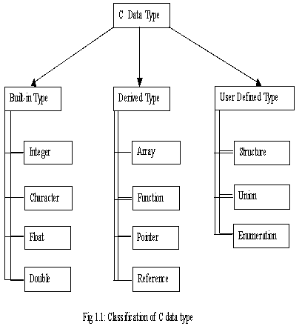
DATA TYPES

Slide 12
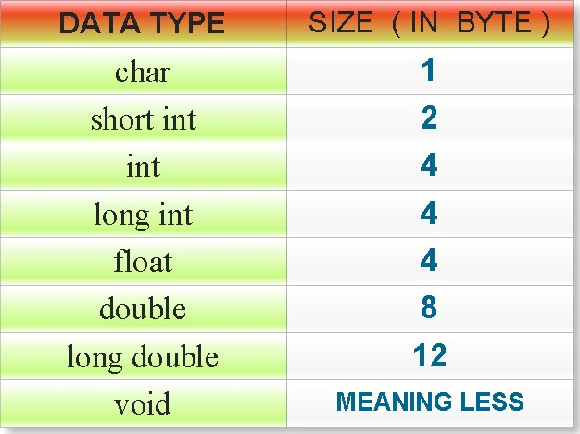
DATA TYPES

Slide 13
MODIFIERS
Modifiers
The data types explained above have the following modifiers.
short
long
signed
unsigned

Slide 14
Type Bytes Range
short int 2 -32,768->+32,767(32kb) unsigned short int 2 0 -> +65,535 (64Kb) unsigned int 4 0 -> +4,294,967,295 ( 4Gb) int 4 -2,147,483,648 -> +2,147,483,647 ( 2Gb) long int 4 -2,147,483,648 -> +2,147,483,647 ( 2Gb) signed char 1 -128 -> +127 unsigned char 1 0 -> +255 float 4 double 8 long double 12

Slide 15
TYPE CAST
Type casting is a way to convert a variable from one data type to another data type. For example, if you want to store a long value into a simple integer then you can type cast long to int. You can convert values from one type to another explicitly using the cast operator as follows:
(type_name) expression

Slide 16
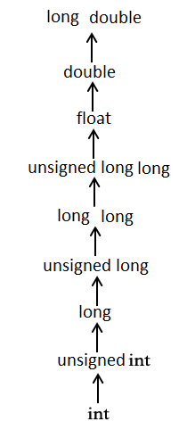

Slide 17
OPERATORS
C Supports a rich set of built in operators. These are :
Arithmetic Operators ( + - * / %)
Relational Operators (< <= > >= == !=)
Logical Operators ( && || !)
Assignment Operators (= += -= *= /= %=)
Increment And Decrement Operators ( ++ --)
Bitwise Operators (& | ^ >> <<)
Special Operators( , sizeof())
Ternary Operator (? : )

Slide 18
OPERATORS
UNARY OPERATORS
These act on single operands.eg: + - ! ~ *
BINARY OPERATORS
These act on tw0 operands.eg: + - * / %
INCREMENT OPERATOR
Two + signs together indicate an increment operator.
i.e. ++
DECREMENT OPERATOR
Two - signs together indicate a decrement operator.
i.e. - -

Slide 19
OPERATORS
Prefix and Postfix increment and decrement operators
x- - ; ➔ postfix-decrement operator
- -x ; ➔ prefix decrement operator
x++ ; ➔ postfix-increment operator
++x ; ➔ prefix increment operator
The prefix increment operator adds one to its operand.
This incremented value is used in the expression to get the result of the expression.
In the postfix form, the increment or decrement takes place after
the value is used in expression evaluation.

Slide 20
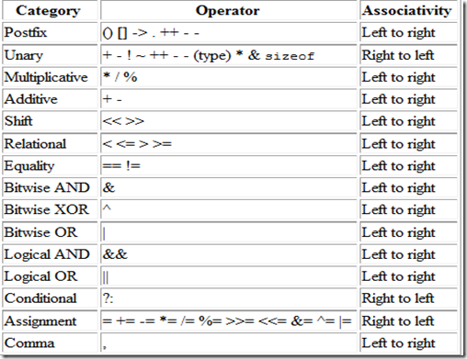
Precedence of Operators

Slide 21
EXPRESSIONS
Arithmetic operations are evaluated using BODMAS rule and then assigned to a variable on left hand side.
C permits mixing of constants and variables of different types in an expression. During evaluation it adheres to strict rules of type conversion. A ‘lower’ type is automatically converted to ‘higher’ type before the operation proceeds. The result is of higher type. This is called Implicit type conversion.
C performs type conversion automatically. However there are instances when we force a type conversion in a way that is different from the automatic conversion. This is called explicit type conversion.
SYNTAX : (type name)expression

Slide 22
THE PREPROCESSOR
A directive is given as a line of source code starting with the # symbol and is processed by the preprocessor before the actual compilation takes place. eg. #include, #define
Include directives use <x.h> (brackets) to indicate that the compiler should look in a “standard” place, such as /usr/include/…
They use “x.h” (double quotes) to indicate that it should look first in the current directory.

Slide 23
THE PREPROCESSOR
Your
source
code
Enhanced and
obfuscated
source code
Object
code
Preprocessor
Compiler

Slide 24
MACROS
A macro is a fragment of code which has been given a name. Whenever the name is used, it is replaced by the contents of the macro .
There are two kinds of Macros. They differ mostly in what they look like when they are used. Object like macros resemble data objects when used. Function like macros resemble function calls.
Object like Macros:
SYNTAX:- #define identifier string
Example:- #define count 100
Function like Macros:
SYNTAX:- #define identifier(f1,f2,….fn) string
here f1,f2,…..fn are the arguments of thee macros.
Example:- #define CUBE(x) (x*x*x)
#define ABS(x) (((x)>0)?(x):(-(x)))

Slide 25
STORAGE CLASS
1> The auto storage class is the default storage class for all local variables.
{ int mount;
auto int month; }
2> The register storage class is used to define local variables that should be stored in a register instead of RAM.
{
register int miles;
}

Slide 26
The static storage class instructs the compiler to keep a local variable in existence during the life-time of the program instead of creating and destroying it each time it comes into and goes out of scope. Therefore, making local variables static allows them to maintain their values between function calls.
The extern storage class is used to give a reference of a global variable that is visible to ALL the program files. When you use 'extern', the variable cannot be initialized as all it does is point the variable name at a storage location that has been previously defined.

Slide 27
INPUT
C has a pre defined function scanf() to take input.
Syntax: scanf(“%x”,&n);
For integer For long long
scanf(“%d”,&n); scanf(“%lld”,&n);
For float For double
scanf(“%f”,&n); scanf(“%lf”,&n);
For character For string
char c; char s[10];
scanf(“%c”,&c); scanf(“%s”,s);
For taking one character as input we can use getchar() function.
Syntax: char c=getchar();

Slide 28
OUTPUT
C has a pre defined function printf() to take input.
Syntax: printf(“%x”,n);
For integer For long long
printf(“%d”,n); printf(“%lld”,n);
For float For double
printf(“%f”,n); printf(“%lf”,n);
For character For string
char c; char s[10];
printf(“%c”,c); printf(“%s”,s);
For giving one character as output we can use putchar() function.
Syntax: char c=‘a’;
putchar(c);

Slide 29
SAMPLE PROGRAM
#include<stdio.h> /* This is a header file */
int main() /* Here starts the Main Function */
{
int a, b, c; /* Declaration of variables */ int r;
scanf(“%d”,&r); /* Taking input
a=2; b=5; /* Initialization of variables */
c=a+b+r;
printf(“Sum is %d”, c); /* Printing */
return 0;
}

Slide 30
FUNCTIONS
A function is a group of statements that together perform a task. Every C program has at least one function, which is main(), and all the most trivial programs can define additional functions.
A function declaration tells the compiler about a function's name, return type, and parameters. A function definition provides the actual body of the function
return_type function_name( parameter list )
{ body of the function }

Slide 31
Call Type | Description
Call by value | This method copies the actual value of an argument into the formal parameter of the function. In this case, changes made to the parameter inside the function have no effect on the argument.
Call by reference | This method copies the address of an argument into the formal parameter. Inside the function, the address is used to access the actual argument used in the call. This means that changes made to the parameter affect the argument.

Slide 32
CONDITIONAL STATEMENTS
These are the statements use to check logical conditions and execute the enclosed code depending upon the output YES / NO or TRUE/FALSE
There are basically two conditional statements in C:
if-else
switch-case

Slide 33
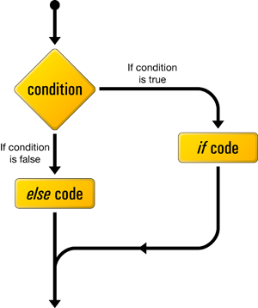
If-else statement

Slide 34
Nested if-else statement
If (test condition 1)
{
if (test condition 2)
{
statement 1;
}
else
{
statement 2;
}
}
else
{
statement 3;
}

Slide 35
Switch-case statement
switch (expression)
{
case value 1:
block 1;
break;
case value 2:
block 2;
break;
……….
……….
default:
default block;
}

Slide 36
Difference between if - else and switch – case
switch-case | if-else
It can check only for equality. | It can check for equality as well as inequality.
It can compare only a variable and a constant. | It can compare 2 variables,2 constants and even a variable and a constant.
It can compare only integers and characters. | It can compare any two types of data.

Slide 37
That’s all folks !!!
☺

